Slide 1
DevOps & Version Control
By Swecha

Slide 2
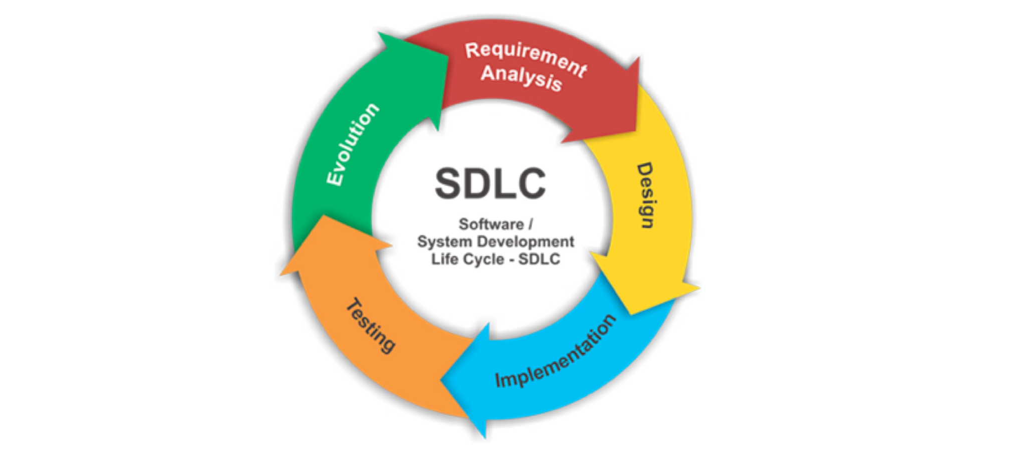
Software Development Life Cycle

Slide 3
What are we trying to do ?
Create a Application ( New Start-Up )
Let say Calculator app
Deliver it to the End-Users
Understand the flow of Software Delivery

Slide 4
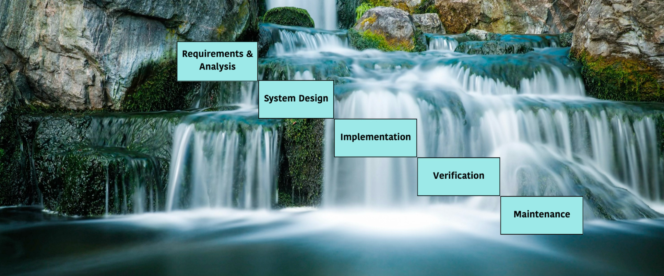
WaterFall Model ( Legacy )

Slide 5
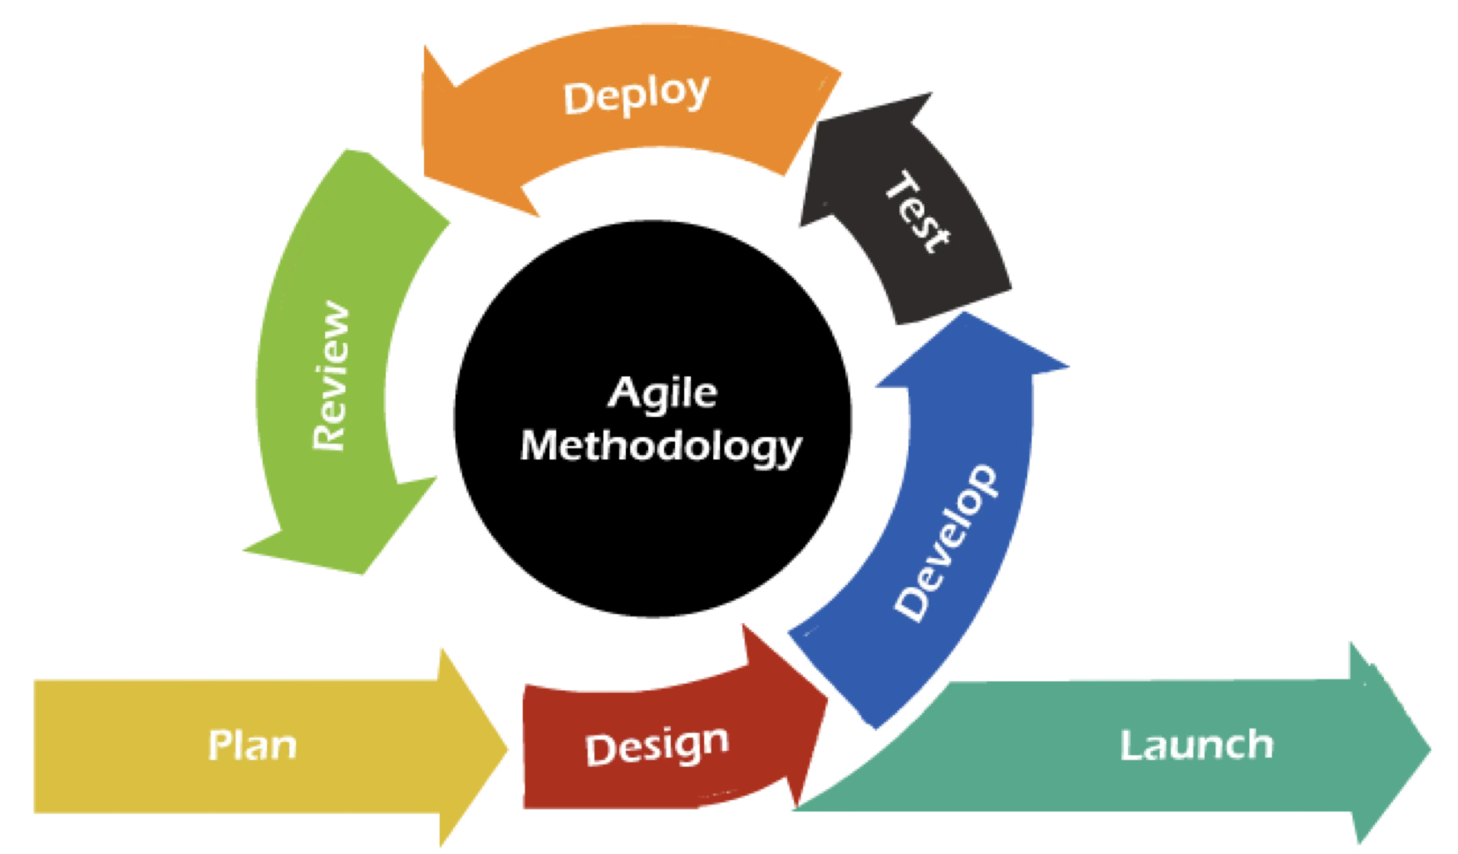
Agile ( Modern )

Slide 6
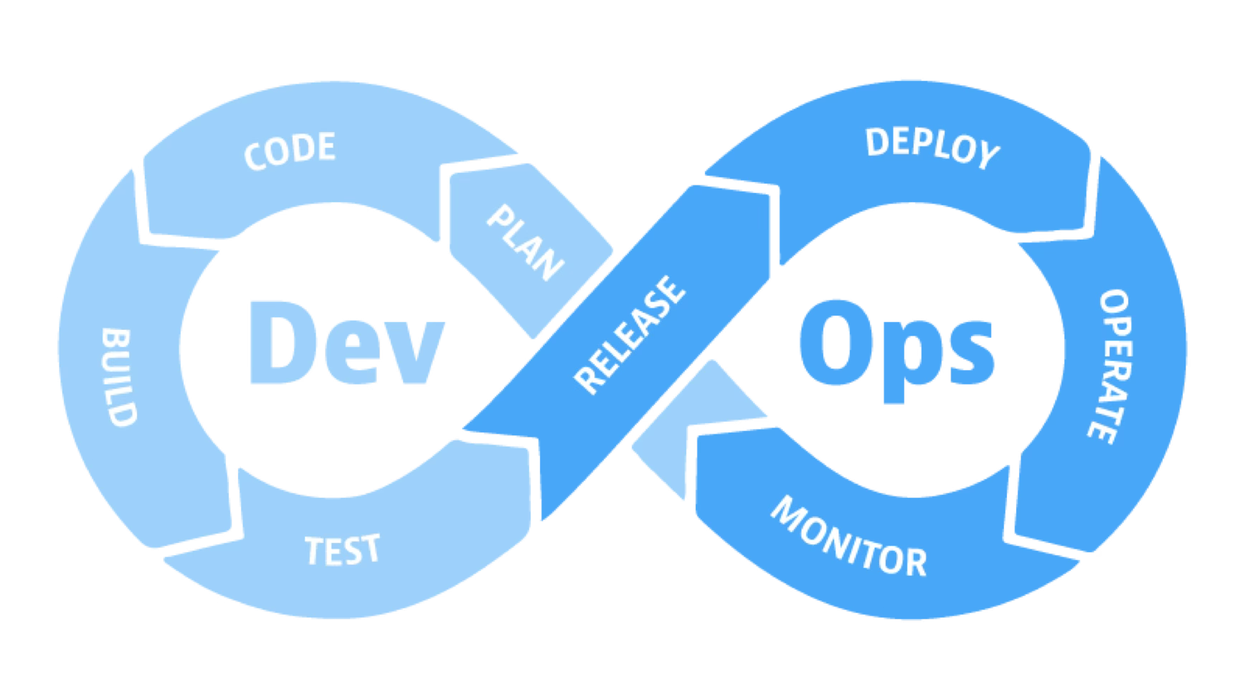
DevOps Industry Standard

Slide 7
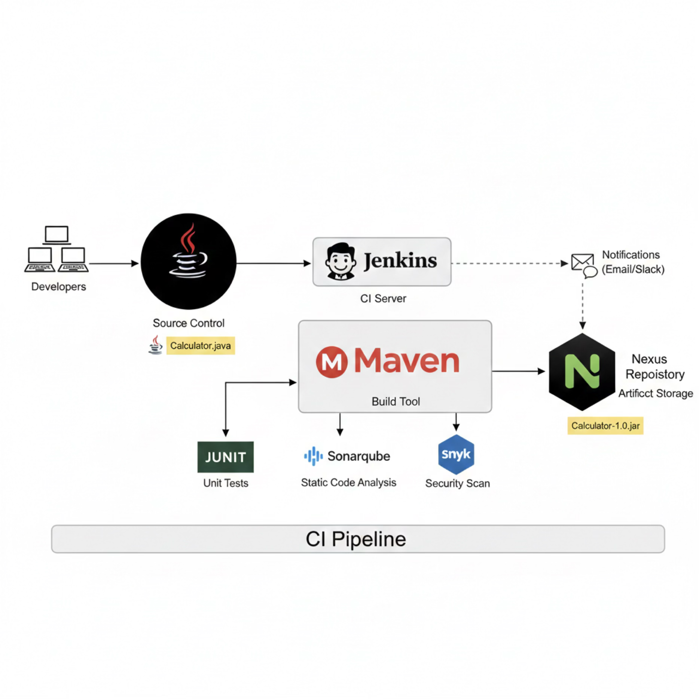
Continuous Integration

Slide 8
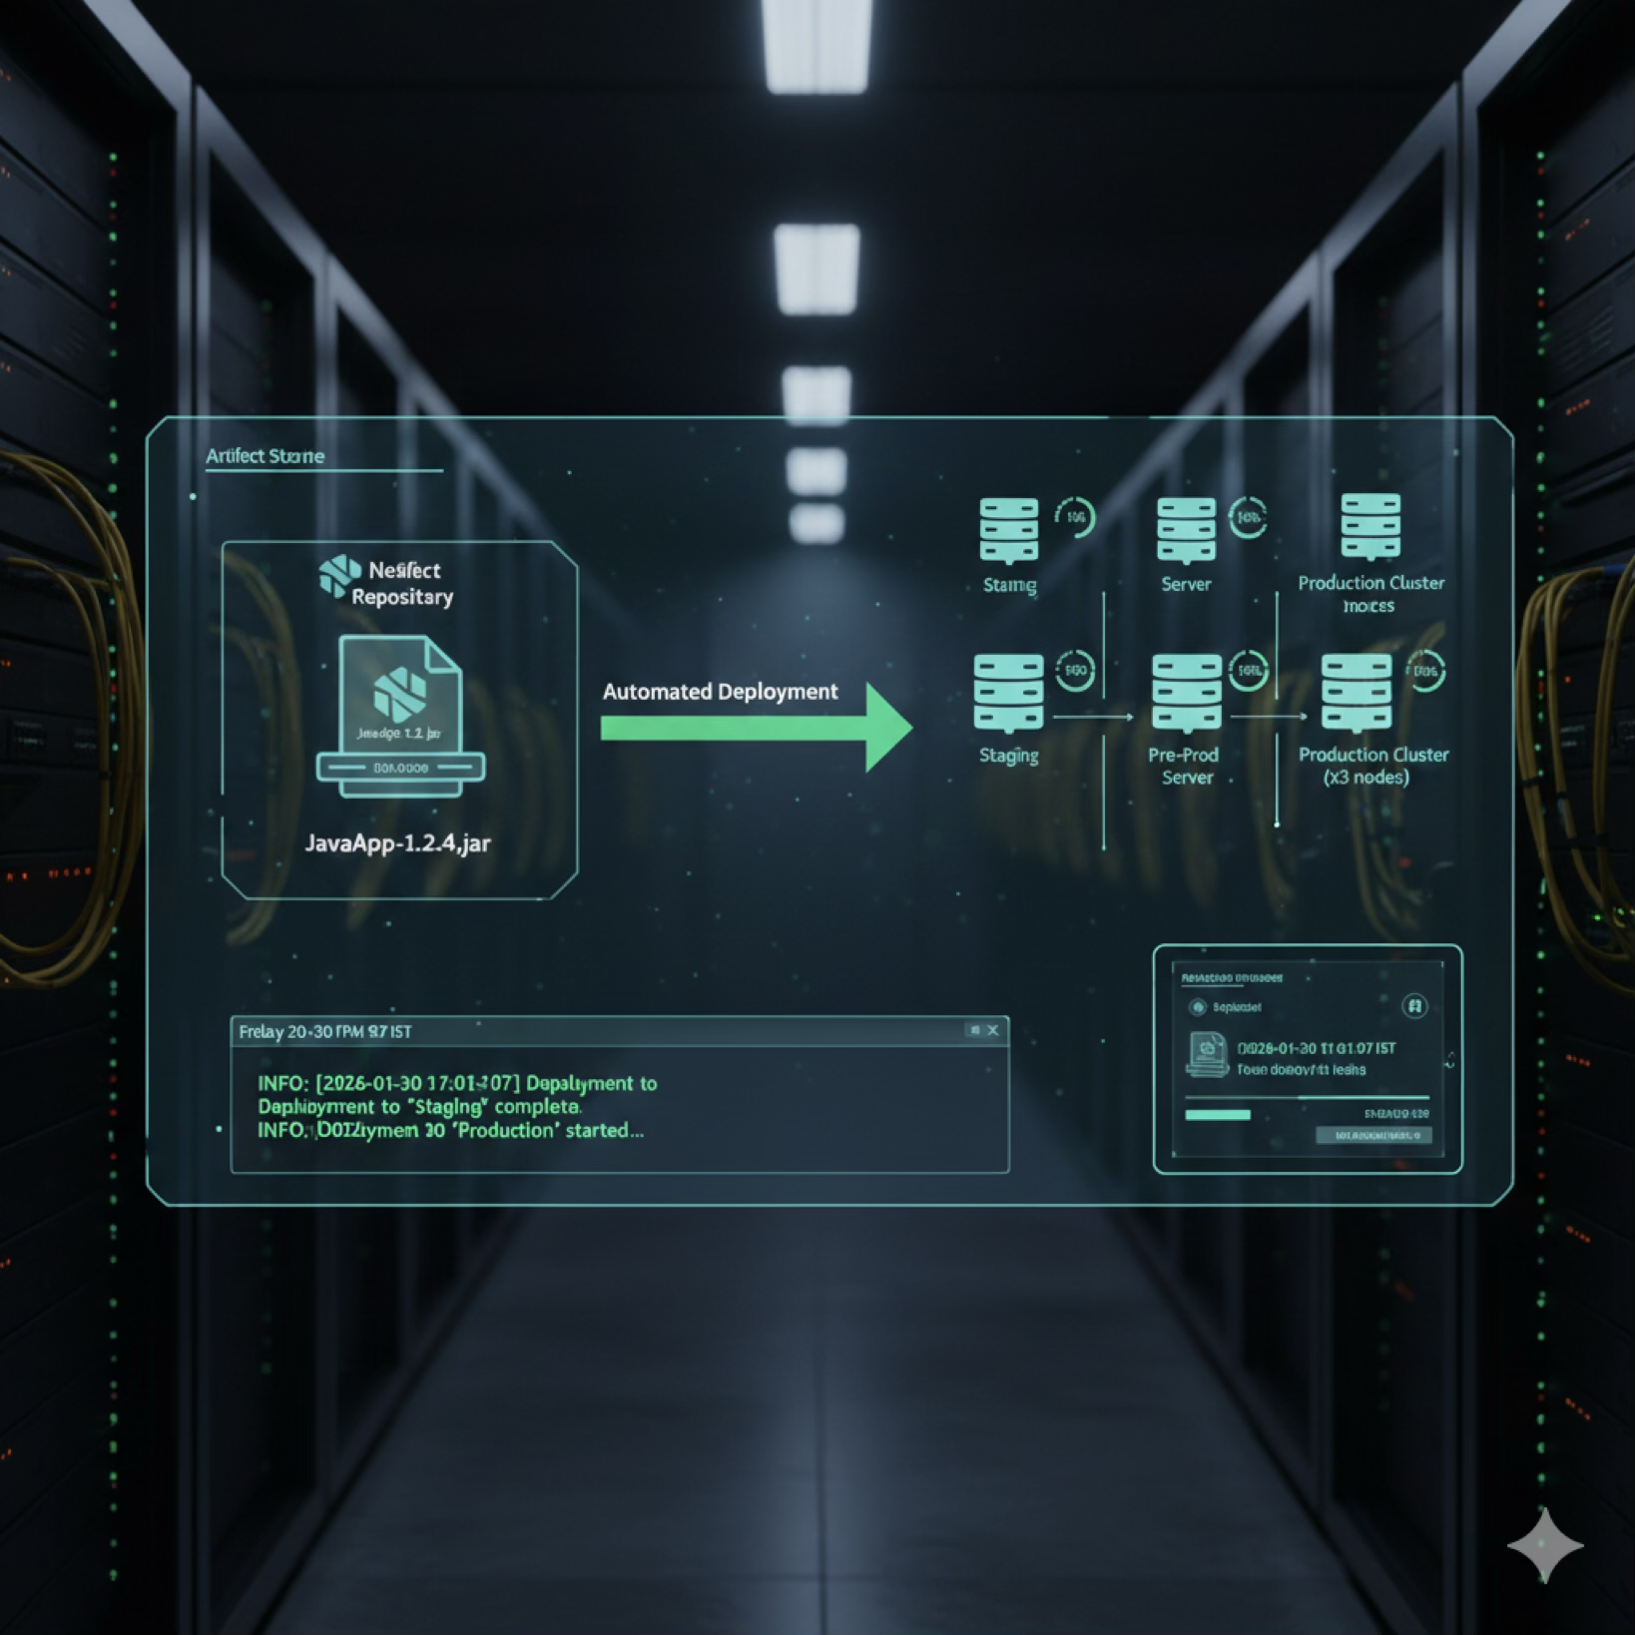
Continuous Delivery/Deployment

